Slide 1
DENGAI: PREDICTING DISEASE SPREAD
Group 18
Jonathan Then Tian Meng
Ong Zhen Ying Melissa
Yong Chai Li
Notes:
Hi we are group 18. Im Chai Li and my team mates are melissa and jonathan.
The challenge that my group took up is to predict the spread of dengue.

Slide 2
AGENDA
01 iNTRODUCTION 02 Objectives 03 Methods Models Train-test split Data pre-processing evaluation 04 Findings 05 Conclusion
Notes:
This slide shows our agenda for today.

Slide 3

INTRODUCTION
With dengue being endemic to Singapore, our team decided to attempt the following:
- Identify significant factors contributing to dengue cases and, if possible, their individual impact on the total number of cases at a point in time; and
- Predict the total number of cases for future periods.
Data on NEA’s website is limited to current data and archive data is no longer available. In search of a better dataset, we decided to use the dataset from the DengAI: Predicting Disease Spread competition
Notes:
At the start of the project around August, it was close to the usual peak of dengue season in Singapore. Therefore, our team was inspired by the many posters around our housing estates to try to predict the number of cases in Singapore.
Unfortunately, NEA does not maintain historical data and we decided to use a competition dataset instead.

Slide 4
Description of dataset
Dataset is a time series recording the total number of dengue cases for San Juan, Puerto Rico (“SJ”) and Iquitos, Peru (“IQ”). There are 25 variables in the dataset, including the number of dengue cases, the target variable.
Variables | Number
Number of cases per week | 1 variable (target)
City and time | 4 variables
Climate (weather and vegetation) | 20 variables
Notes:
The dataset is for San Juan and Iquitos. The target variable is the number of cases per week. There are variables on the city and time, showing that the dataset is a time series at different locations.
There are also 20 climate variables indicating the weather, like temperature and humidity, and vegetation.

Slide 5
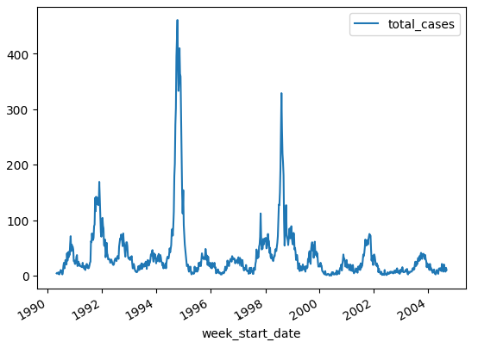
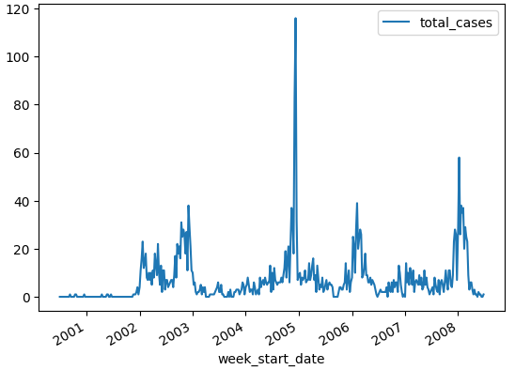
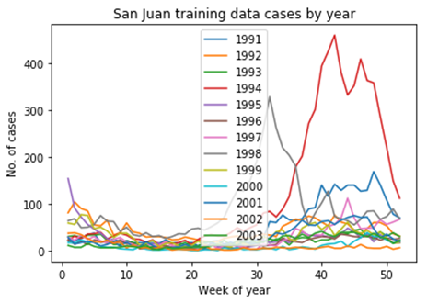
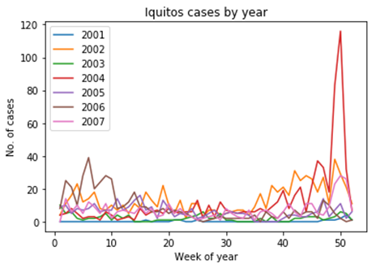
Number of cases appear to have seasonality
San Juan
Iquitos
Notes:
The number of cases for the training period is shown in the graphs on top.
When we overlayed the data year on year in the graphs below, it appears to have some seasonality, which is consistent with our understanding of having a dengue season in Singapore.

Slide 6
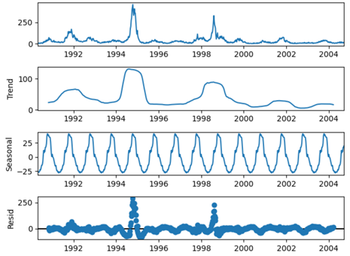
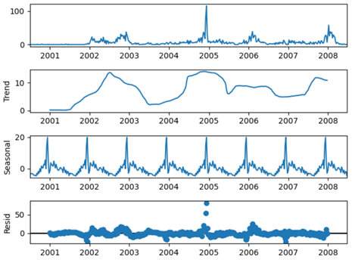
Data Decomposition shows seasonality
San Juan
Iquitos
Notes:
The data decomposition also shows that there is seasonality of 1 year (52 weeks).

Slide 7
objectives
Predict the total number of dengue cases (“total_cases”) for each city for the last 20% of the training dataset provided:
Week 40 of 2004 to Week 17 of 2008 for San Juan
Week 27 of 2008 to Week 25 of 2010 for Iquitos
There are no total_cases label for the test dataset provided.
Notes:
After examining the data, we further defined our objectives to predicting the total number of dengue cases for each of the cities for the last 20% of the dataset.
Although there was a test set for the competition, there was no real number of cases for that period provided. Therefore, part of our training set was used as the test set.

Slide 8
Methods (models)
Most appropriate | → | Least appropriate
Time series forecasting models, with seasonality | Neural networks which can analyse normal time series | Machine learning models as benchmark
Seasonal Auto-Regressive Integrated Moving Average with eXogenous factors (SARIMAX) | LSTM | Multilinear Regression
Holt Winters | CNN | Random Forest
Notes:
Since there appears to be seasonality, we used time series forecasting models with seasonality, then went on to neural networks which could analyse normal time series, and then picked two machine learning models as a benchmark.

Slide 9
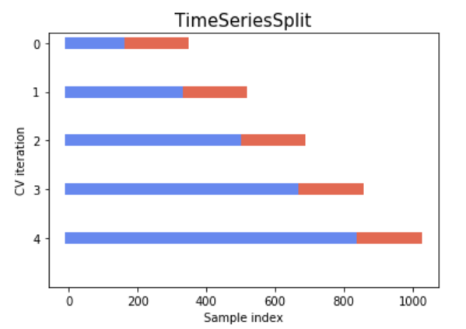
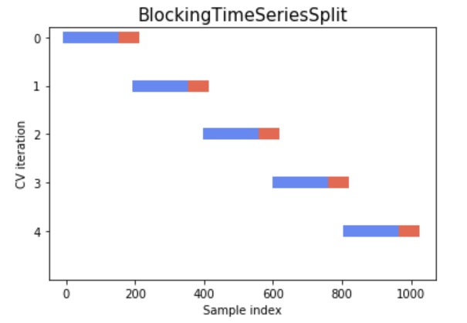
Methods (train-test split)
Split at ratio of 80:20, higher end of the standard range, to have more training data because the dataset is small.
Time Series Split Cross Validation instead of Blocked Cross Validation due to the same concern about the lack of data points.
Chosen
Notes:
We decided on having 80% training data, which is the higher end of the standard range because there is only 1,456 datapoints in this entire dataset, which is quite small. (936 datapoints for San Juan and 520 for Iquitos)
For the same reason, we chose the Time Series Split Cross Validation instead of the blocked cross validation.

Slide 10
Methods (Data pre-processing)
Null values
Feature selection
Filled in the null values using the forward fill method.
San Juan and Iquitos have tropical climates, the vegetation, temperatures and precipitation factors would not change much week on week.
Dropped 6 highly correlated variables (>90%) based on a grid search.
>90% correlated variables in San Juan OR >90% correlated variables in Iquitos.
Variables are from the same source and measure the same climate variables, correlation between the climate variables are likely the same.
Notes:
Before doing the models, we processed the data in two common ways:
-filling forward null values;
- dropping features that were highly correlated.

Slide 11
Methods (Evaluation)
mean squared error which is a standard for regression problems
Notes:
For evaluation, we decided to use the mean squared error, which is the standard for regression problems.

Slide 12
findings

Slide 13
Time series forecasting models
Notes:
For time series models, we tried 3 models, namely the holt winters and the SARIMA/SARIMAX models.

Slide 14
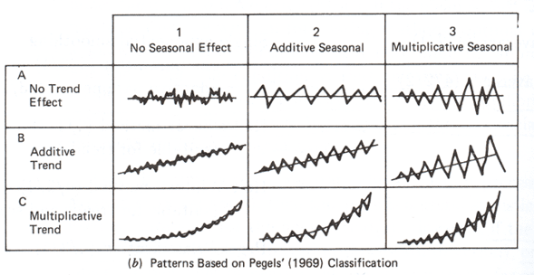
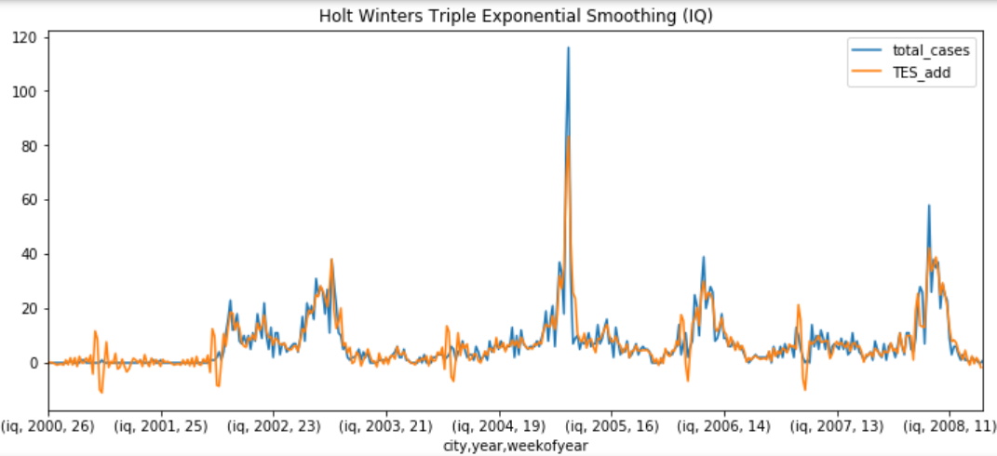
Holt-winters model
Used for time series forecasting
Three aspects of the time series: a typical value (average), a slope (trend) over time, and a cyclical repeating pattern (seasonality)
No trend with additive seasonality
Seasonal period of 52 weeks
Notes:
The first model is the Holt Winters which is a univariate model. It contains three aspects, a typical value/average, a trend and a seasonal pattern. Looking at the data, we see that there is no discernible trend. In addition, we observe that there is an additive seasonal pattern with a period of 52 weeks.
We used the Augmented Dickey Fuller Test to test the data for stationarity. Basically, stationary datasets are those that have a stable mean and variance. Even though we observed seasonality in the data decomposition, based on the ADF test, the training data for both cities are stationary. Hence, we did not perform any differencing.

Slide 15
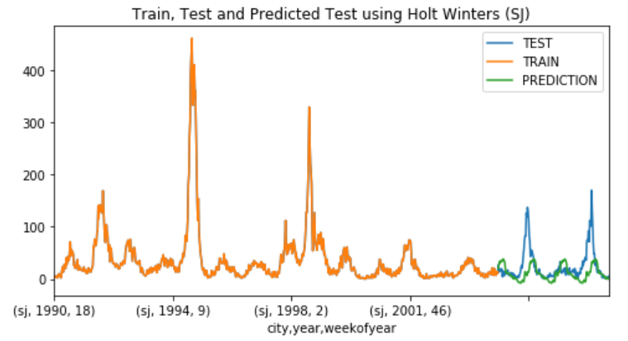
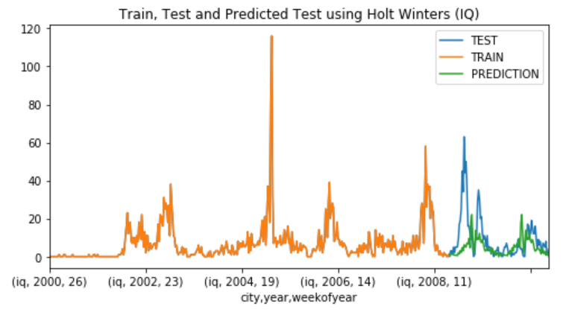
Holt-winters model
Predictions for San Juan
Predicted cases goes below zero at certain points
Unable to predict for spikes
5-Fold CV MSE: 222.652
Predictions for Iquitos
Sharp increase followed by a sharp decrease followed by an increase
5-Fold CV MSE: 53.843
Notes:
We fitted the model onto our data and did 5-fold cross validation to get the mean squared error. For the San Juan dataset, the predicted cases have a relatively smooth cyclical pattern. However, the predictions shows that the total cases go below zero at certain points. As for Iquitos, we can see that it modelled the seasonal patterns relatively well. However, for both models, they were unable to account for the outlying spikes.

Slide 16
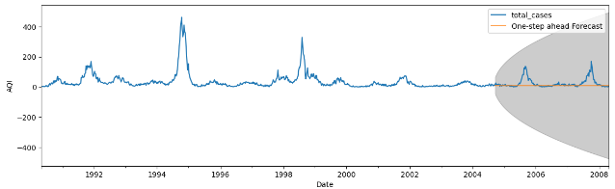
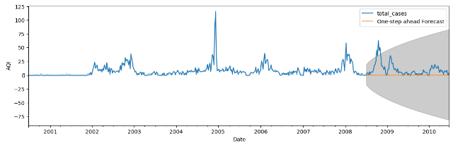
SARIMA
San Juan
Grid search of AIC resulted in no seasonality orders for the best fit models for both cities
Best model for San Juan is (2,1,1)(0,0,0)[52] and the best model for Iquitos is (3,1,0)(0,0,0)[52]
Iquitos
Notes:
Next, for the SARIMA model, it also is a univariate model. There are a total of 7 elements. The first three elements represent the trend autoregression, the trend difference and the trend moving average respectively. The next three elements represent the seasonal orders of autoregression, difference and moving average. The last element represents the number of time steps for a single seasonal period, which in our case is 52 weeks.
We used a grid search to minimize AIC and the best fit models for the data are plotted. Despite the data decomposition showing a seasonal component, the best fit models did not include seasonal orders and resulted in predictions that were almost flat lines.

Slide 17
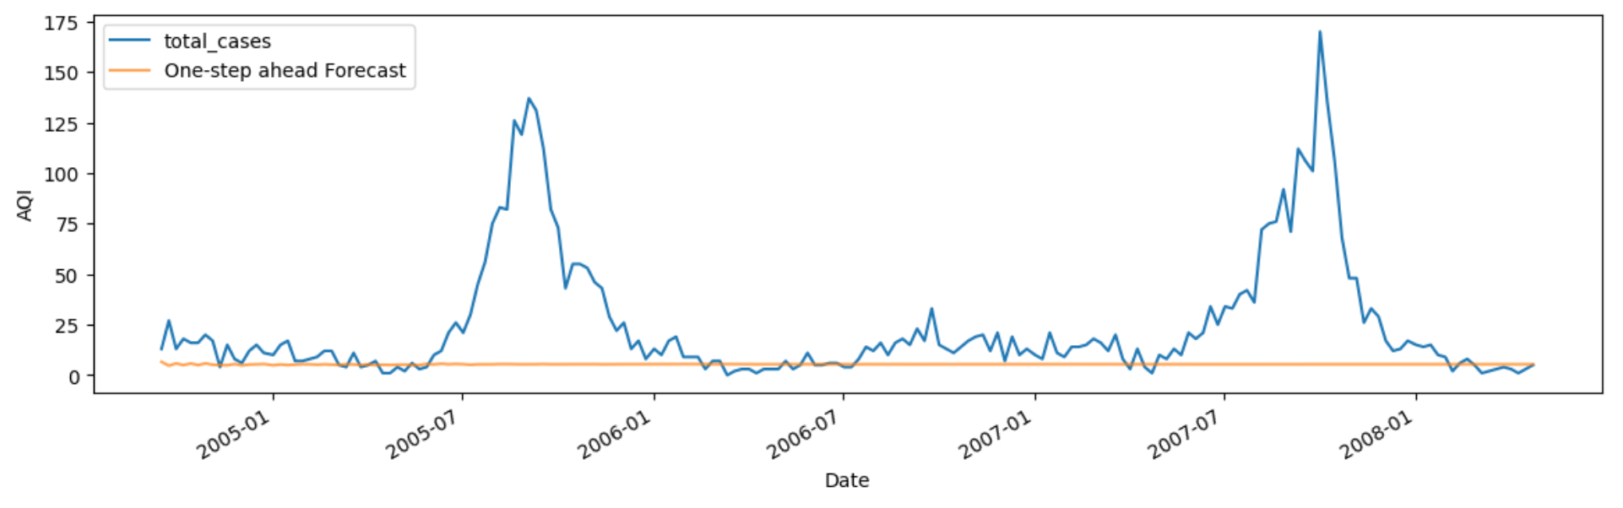
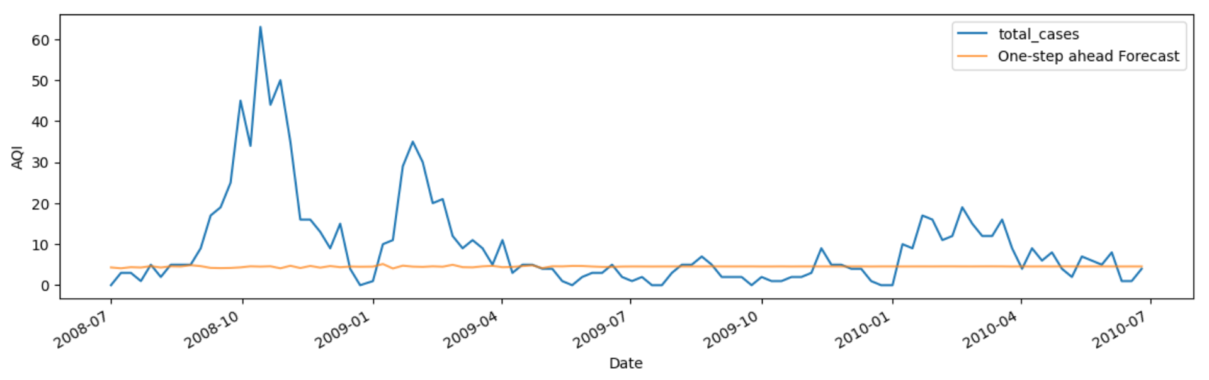
SARIMAX
San Juan
Grid search of AIC resulted in no seasonality orders for the best fit models for both cities
Best model for SJ is (2,0,1)(0,0,0)[52] and the best model for IQ is (3,0,0)(0,0,0)[52]
Iquitos
Notes:
Lastly, we modelled the SARIMA with eXogenous factors (SARIMAX) model which considers the external variables that the time series before did not.
We note that the exogenous variables were not stationary. Hence, the data was differenced once. Differencing means calculating the difference between consecutive observations. After differencing, we scaled the data as the exogenous variables are of different scales. We then proceeded to perform the grid search to minimise AIC.
The best models are shown and again, there are no seasonal components. The predicted results are also almost flat lines.

Slide 18
Neural networks
Notes:
Next, we tried modelling neural networks.

Slide 19
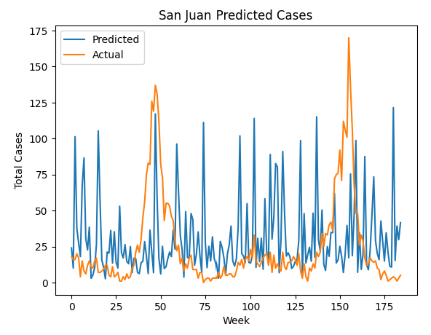
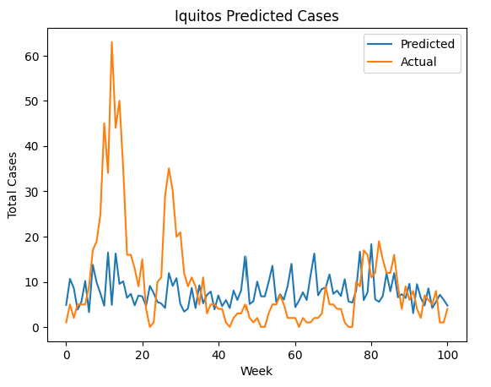
convolutional neural network
San Juan
Iquitos
Single shot model: Model makes the entire sequence prediction in a single step
1D convolutional layer was built to take in 2 weeks of data and output 2 weeks of predictions
Filters on first layer = 256, kernel size = convolution window size (2), activation function = “relu”
A dense layer was added, with activation function = “elu”
No pooling layer as it would cause a negative effect on time series data with seasonality and trends¹
¹https://ieeexplore.ieee.org/document/8823990
Notes:
For CNN, a Conv1D layer was used as time series has a strong one dimension locality (which is time itself). The time step window was set at 2 weeks of data to match the lifecycle of the mosquitoes. No pooling layer was added as according to a study, pooling layers tend to introduce negative effects for seasonal time series data with trends. From the charts, we can see that the models’ predictions are erratic, and a 2-week window may not be appropriate.
Due to time constraints, we were unable to perform a grid search on the optimal number of layers and filters. We did however play around with the epoch which is set to 20 currently and noticed that the higher epochs, for example, 200, led to higher errors possibly due to lack of data and overfitting.
My groupmate Jonathan will go through the rest of the models.

Slide 20
LSTM – best model
City​ | No. of time steps considered | No. of layers | No. of neurons in 1st layer | No. of neurons in 2nd layer, if any | MSE
San Juan​ | 2 | 1 | 75 | NA | 1115.900
Iquitos​ | 2 | 2 | 50 | 50 | 141.864
Range of variables considered | [1,2] | [1,2] | [25,75] | [25,75]
Notes:
The results of the best LSTM models are shown in this slide. The mean squared error is quite high for San Juan and lower for Iquitos.

Slide 21
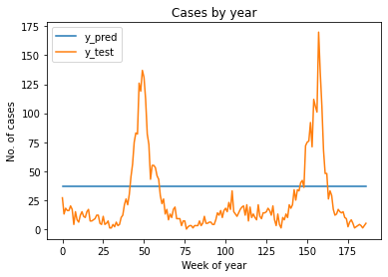
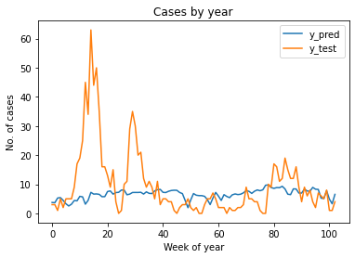
Predicted values vs test set

Slide 22
LSTM - bases
Upper range of values for grid-searched variables was based on the following:
Number of time steps considered was based on how long it takes for a mosquito to hatch and become infectious (around 2 weeks)
Two hidden layers for full generality and one hidden layer with an arbitrarily large number of units suffices for the "universal approximation" property¹
Number of neurons chosen was slightly less than a reasonably large number due as the training samples are limited²
Used 5-fold cross validated results to select the best model
Scaled inputs using standardised scaler as measurements of natural phenomenon tend to follow a normal distribution
Activation function is Relu in the hidden layer(s) because only positive results are wanted
Activation function is linear for the output layer because predicted value should be a continuous-valued targets with no known bounds³
¹http://www.faqs.org/faqs/ai-faq/neural-nets/part3/section-9.html
²Lecture 8 page 12
³http://www.faqs.org/faqs/ai-faq/neural-nets/part2/section-10.html
Notes:
For the LSTM model, we had to standardise the data, reshape it so that it is 3 dimensional, and use cross validation to select the best parameters for the model.
We used Relu for the hidden layers because number of cases can only be positive, and the linear activation function for the output for because the output is expected to be a continuous with no known bounds.

Slide 23
Machine learning models

Slide 24
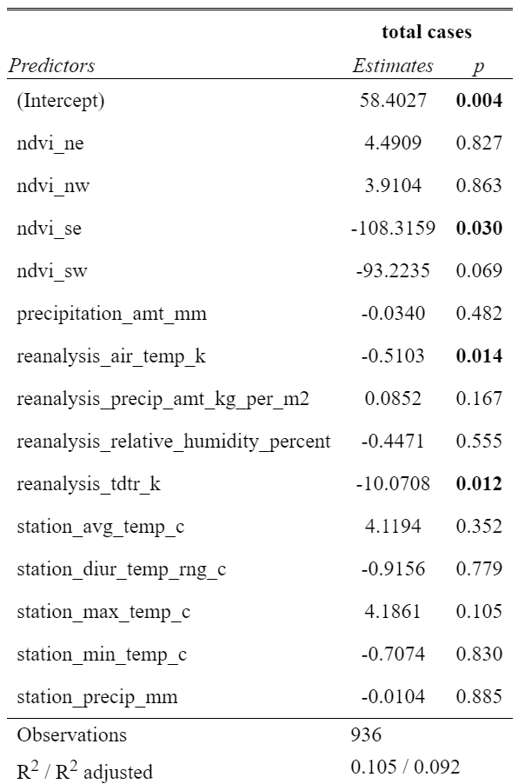
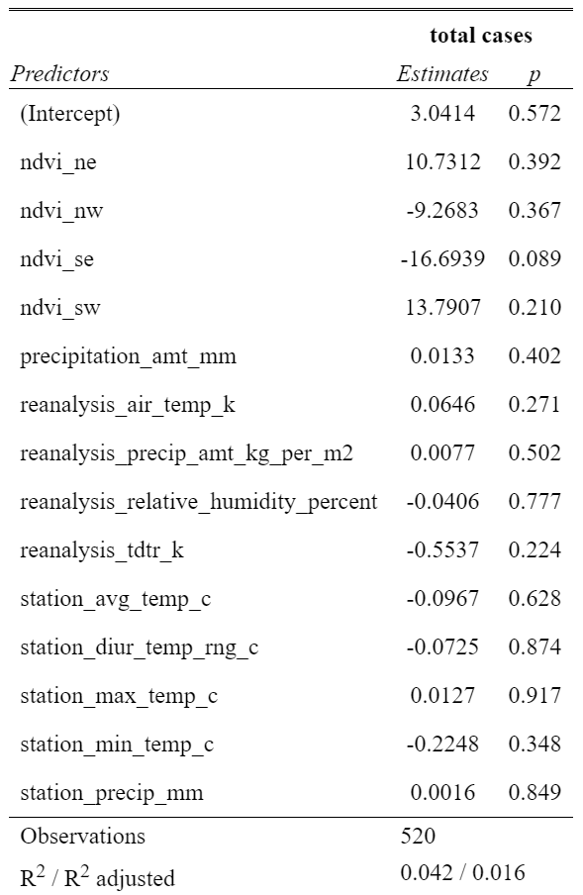
Multilinear Regression (Full model)
San Juan
Iquitos
Notes:
Multiple linear regression was conducted over the full model using the datasets of San Juan and Iquitos. From the images shown below, we can see that the R-squared values produced by the full models are very low. This indicates that the independent variable, total cases of dengue, is not being explained much by the 14 predictors.

Slide 25
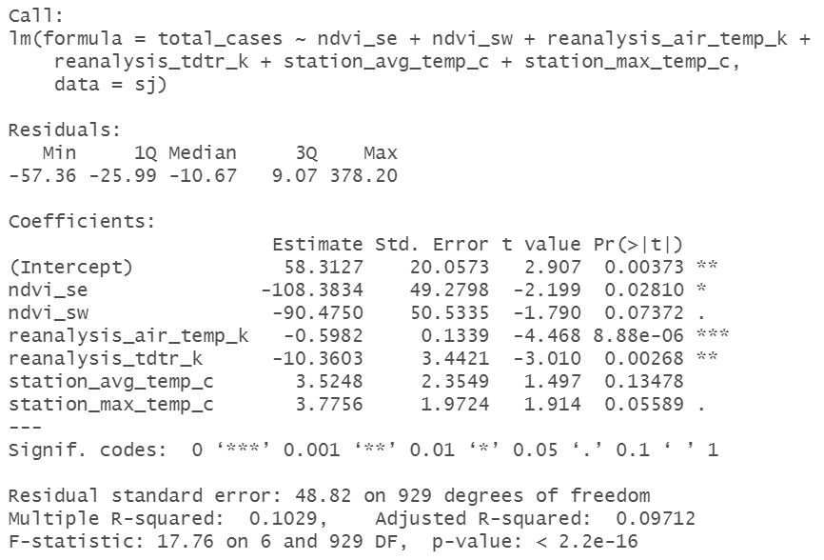
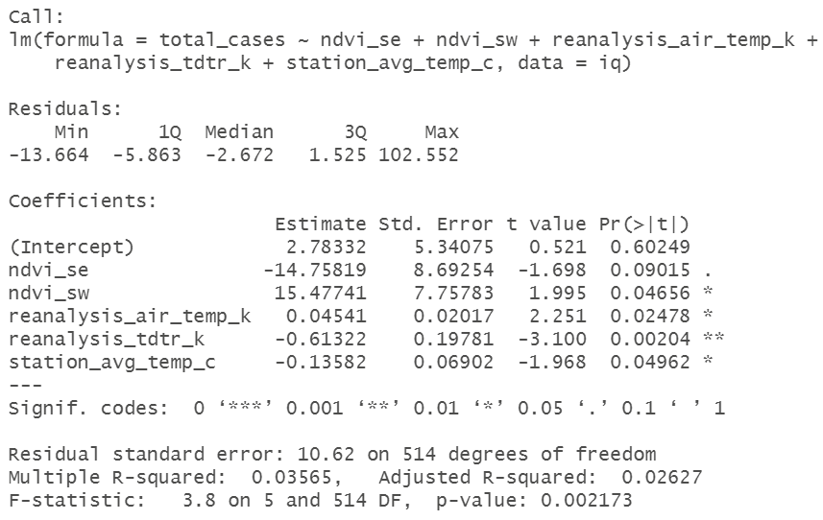
Multilinear Regression (SUBSET model)
San Juan
Iquitos
Notes:
To determine if there is a better model using a subset of the variables, we decided to perform variable selection using the stepwise method. There are two stepwise methods we can do, forward stepwise selection and backward stepwise selection. We chose to use the backward stepwise selection with Akaike Information Criterion (AIC) as the selection method, as starting with the full model has the advantage of considering the effects of all variables simultaneously.

Slide 26
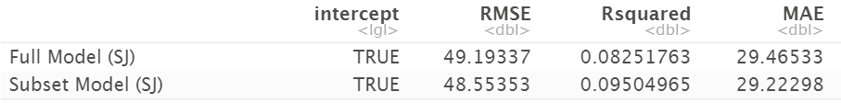

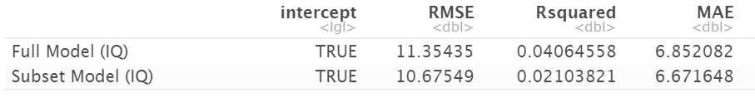

Multilinear Regression 5-Fold cross validation
San Juan
Iquitos
Notes:
To estimate the skill of the linear regression models on unseen data, we performed 5-fold cross validation on all four models using the caret package. The package provides us with the RMSE and we can easily calculate the MSE by squaring the smaller RMSE of the two models. The MSE are 2357.44 and 113.97.

Slide 27
Random forest – best model
City​ | No. of time steps considered | Max depth | Min leaf sample | Mean squared error​
San Juan​ | 2 | 15 | 10 | 123.326
Iquitos​ | 1 | 5 | 4 | 42.413
Range of variables considered | [1,2] | [5,20] | [2,10]
Notes:
The results of the best random forest models are shown in this slide. The mean squared error is quite low.

Slide 28
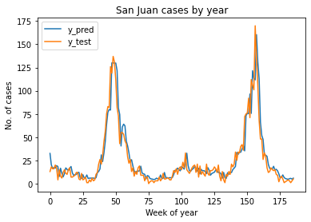
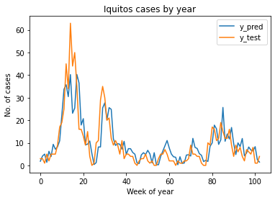
Predicted values vs test set

Slide 29
Random forest - bases
Changed data from time series to supervised learning set using sliding window method
Upper range of values for grid-searched variables was based on the following:
Number of time steps considered was based on how long it takes for a mosquito to hatch and become infectious (around 2 weeks)
Decision tree regressor built with the first set of training data
Used 5-fold cross validated results to select the best model
Notes:
We had to prepare the dataset by concatenating the data from different dates together to make it a supervised machine learning problem.
We then did a grid search with 5 fold cross validation to determine what the best model was.

Slide 30
conclusion

Slide 31
Random forest performed the best
City | MODEL | MSE
San Juan | Random Forest | 125.580
 | Multilinear Regression | 2357.445
 | LSTM | 1115.900
 | CNN | 306010.40 2098.466
 | Holt Winters | 222.652
 | SARIMA | 1195.94
 | SARIMAX | 1344.04
Iquitos | Random Forest | 43.858
 | Multilinear Regression | 113.966
 | LSTM | 141.864
 | CNN | 13738.995 71.588
 | Holt Winters | 53.843
 | SARIMA | 209.53
 | SARIMAX | 155.75
Notes:
In contrast to our expectations, the random forest performed the best out of all the models.

Slide 32

why did the random forest do well?
Possible reasons:
Able to deal with non-linear relationships, for example the spikes in infections in certain years
Good for high dimension problems because it uses only a subset of features each time, helping with leftover highly correlated variables (as high as >80%)
Avoids scaling issues
Disadvantage:
Not interpretable
Notes:
This may be due to its ability to deal with potential non-linear relationships, like sudden spikes in the total infections per week in 1994 in San Juan.
It is also good for high dimension problems because only a subset of features are used for each tree. This helps deal with the problem of feature selection because many of the variables were highly correlated although they measured different things.
It also avoids scaling issues.
However, we note the disadvantage of random forests, that results are not interpretable.

Slide 33
Improvements if there were more time
Grid search on more variables to tune models and at smaller intervals
Grid search on the activation functions for neural networks
Anomaly detection using Brutlag Algorithm for Holt Winter
Exploring the logarithm of variables to prevent negative values in the time series forecasting models
Exploring autoregressive models in NN as they are able to predict stepwise outputs and feed it back to the model for the prediction to be conditioned upon the previous
Notes:
If there were more time, we would like to improve on our project by doing a grid search on more model parameters.

Slide 34
THANKS!
Do you have any questions?

